Slide 1
Kinematics
Pre-class (1 to 11)
in-class (13 onwards)

Slide 2
Kinematics
Kinematics is a part of mechanics that enables us to describe motion.
We need to define some physical quantities which can help describe motion in one, two and three dimensions.

Slide 3
Motion in one dimension
The simplest kind of motion is motion in a straight line.
Examples of this kind of motion include an object moving on a straight road and a stone thrown vertically upward.
We will assume that the objects are represented by point particles instead of considering them as extended objects.

Slide 4
Motion of a particle in a straight line
To describe the motion of a particle, we need a coordinate system.
We choose the x-axis with an origin O to lie along the road.
The change in the particle’s coordinate x over a time interval will describe the motion of the particle over that time interval.

Slide 5
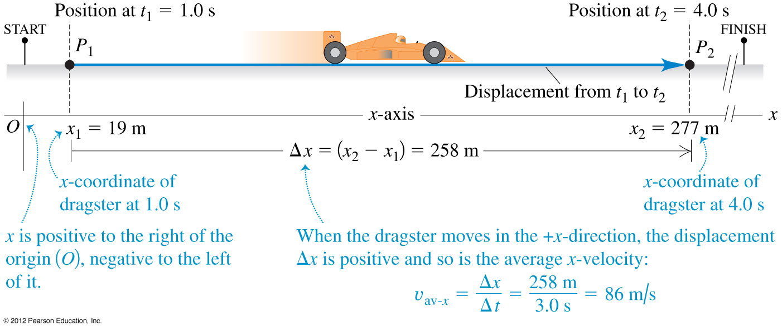
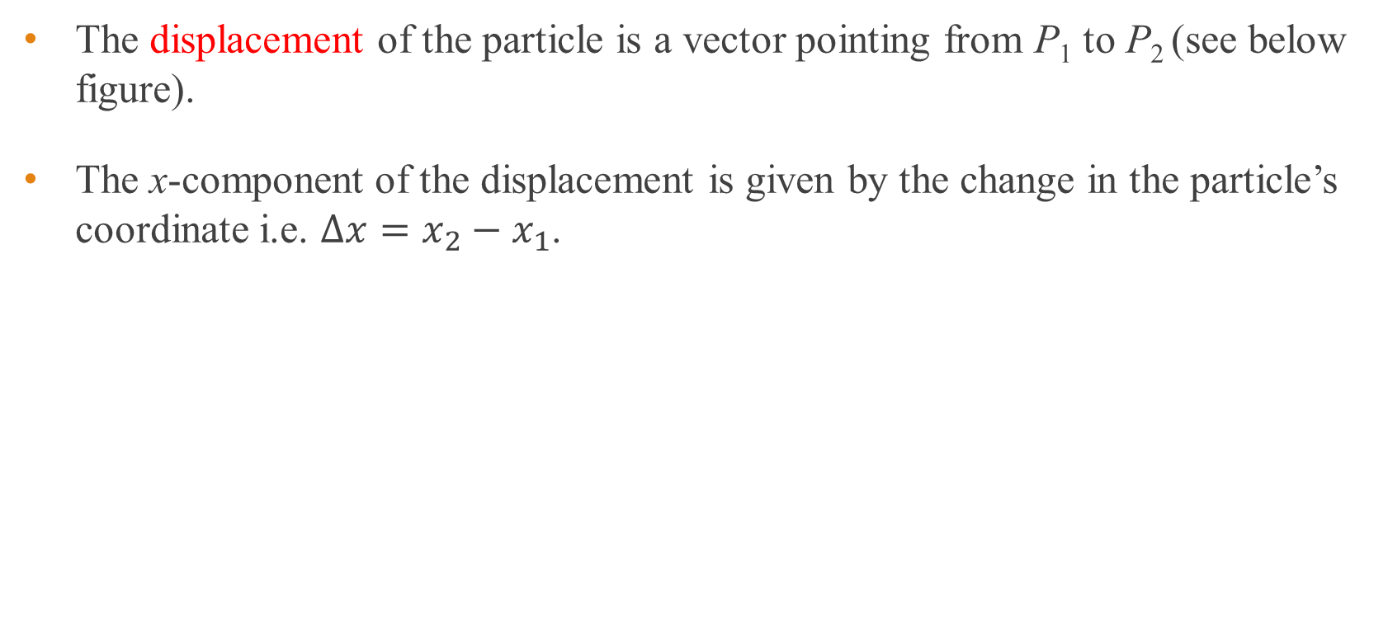
Displacement
The displacement of the particle is a vector pointing from P₁ to P₂ (see below figure).
The x-component of the displacement is given by the change in the particle’s coordinate i.e. $Δx=x_{2}−x_{1}$.

Slide 6
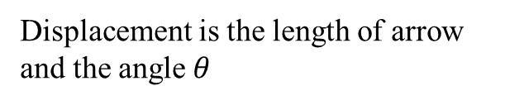
Distance vs displacement
Distance is the length of the path travelled by an object.
Displacement is the straight line length from the start point to the end point plus the direction of that line with respect to a reference direction.
Distance is a scalar and displacement is a vector.
y
Distance = Length of curve
Displacement is the length of arrow and the angle $θ$
θ
O
x

Slide 7
Example 1
Smoke particle undergoes Brownian motion from O to A to B to C to D.
a) What is the distance travelled to D from O? b) What is the displacement of D from O?
A
C
O
B
D

Slide 8
Example 2
A body moves in a circle in the clockwise direction starting from O to E.
a) What is the distance travelled by the body from O to E? b) What is the displacement of the body at E from O? c) What is the distance travelled by the body when it returns to O? d) What is the displacement of the body when it returns to O?
O
E
Notes:
Arc length OE
Vector OE
2πR
Displacement will be zero

Slide 9
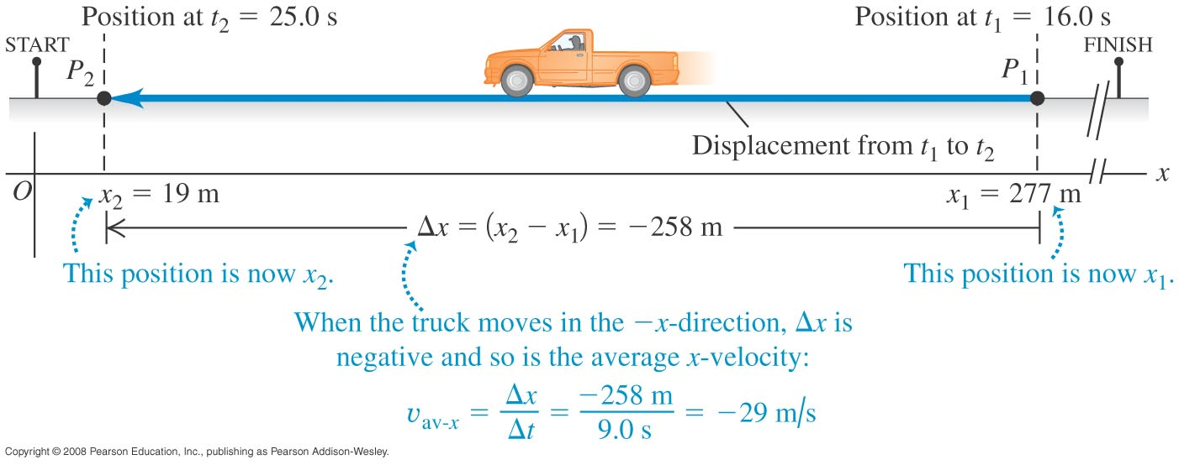
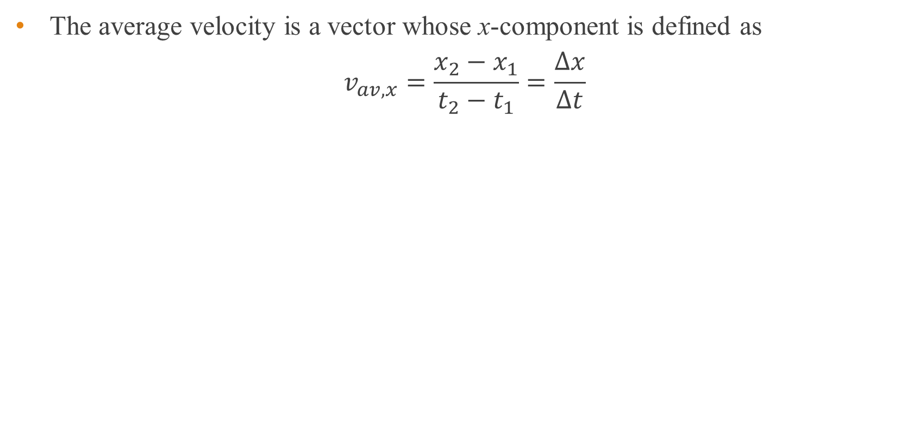
Average velocity
The average velocity is a vector whose x-component is defined as
$$v_{av,x}=\frac{x_{2}−x_{1}}{t_{2}−t_{1}}=\frac{Δx}{Δt}$$

Slide 10
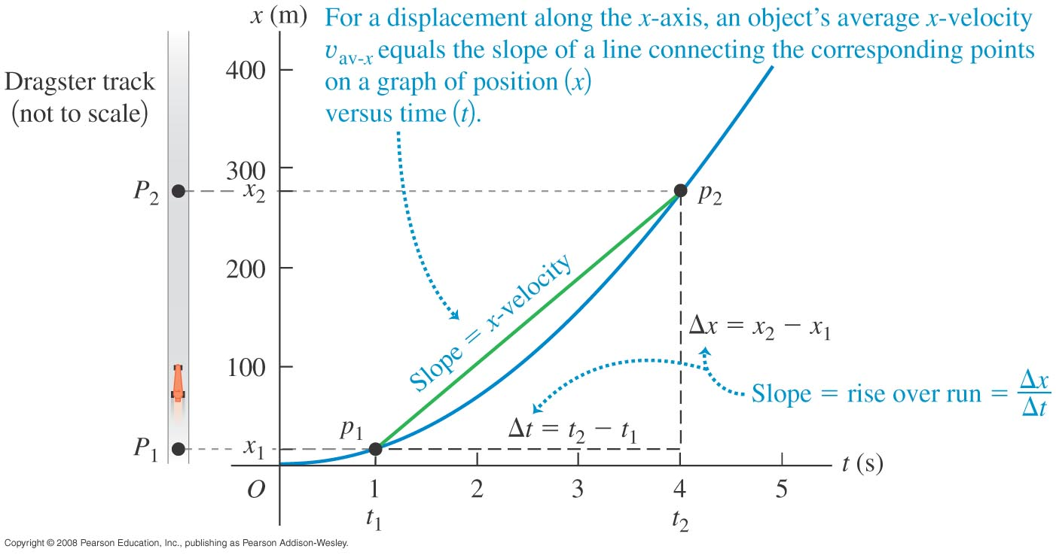
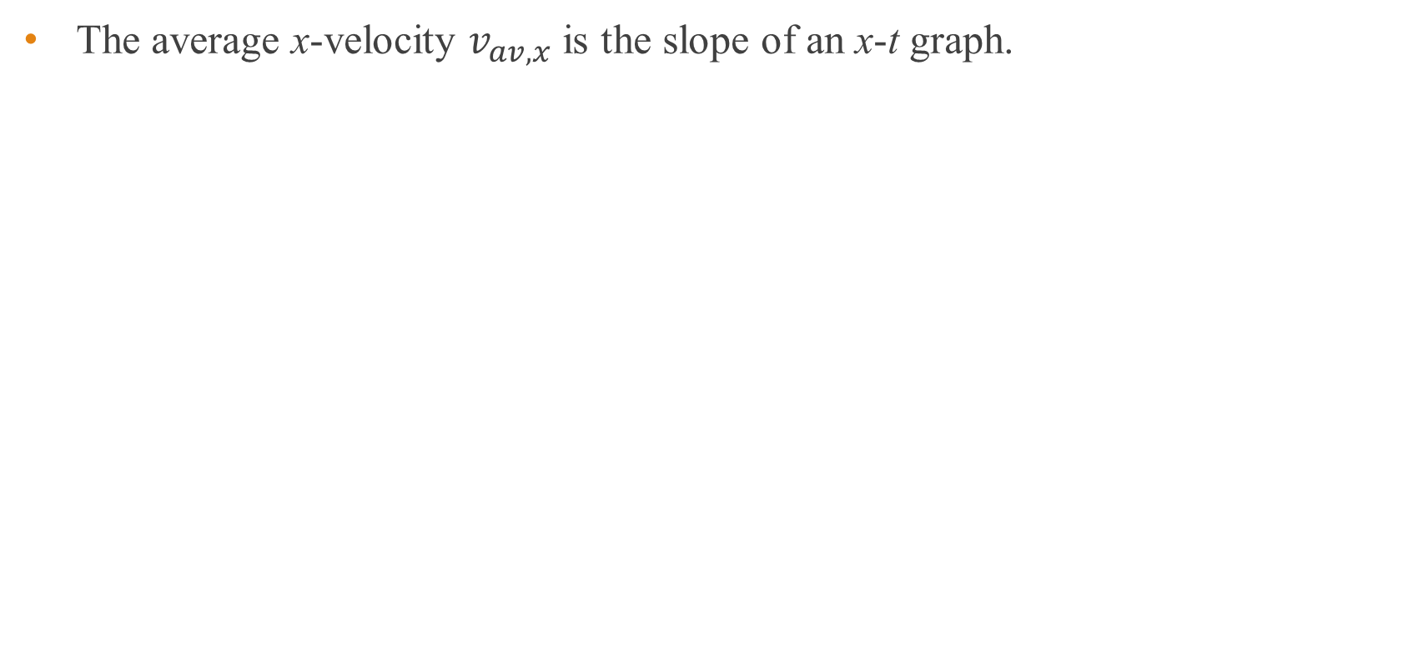
Position-time graph x-t graph
The average x-velocity $v_{av,x}$ is the slope of an x-t graph.

Slide 11
Speed and velocity
Average speed is distance divided by the time taken.
Average velocity is the displacement divided by time taken.
The average speed is greater than or equal to the magnitude of the average velocity.
y
Distance = Length of curve
Average velocity = Displacement/time It points in the same direction as displacement
θ
O
x

Slide 12
End of pre-class slides

Slide 13
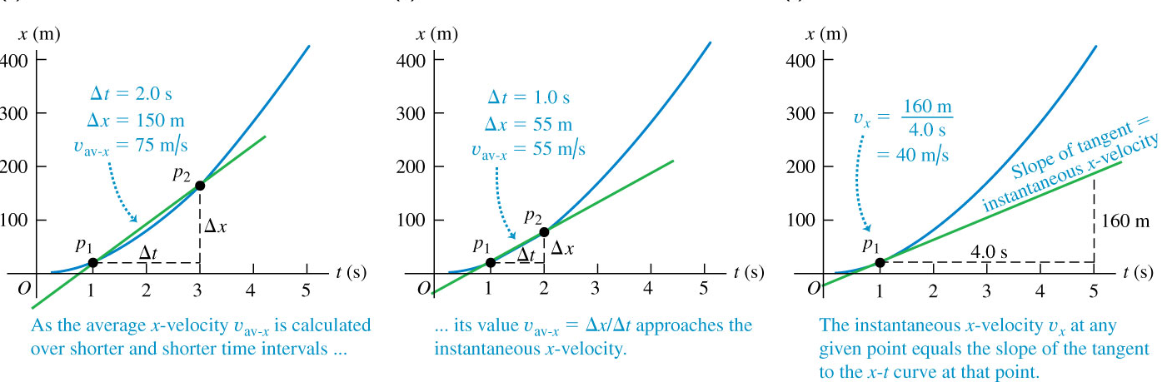
Instantaneous velocity for straight line motion
The average velocity of a particle during a time interval can’t tell us how fast or in what direction the particle was moving at any given time during the interval.
Therefore we introduce the concept of instantaneous velocity which is the velocity at a specific instant of time or specific point along the path.

Slide 14
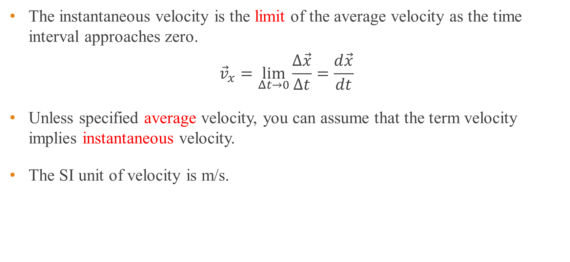
Instantaneous velocity for straight line motion
The instantaneous velocity is the limit of the average velocity as the time interval approaches zero.
$${\vec{v}}_{x}=\lim_{Δt→0}{\frac{Δ\vec{x}}{Δt}}=\frac{d\vec{x}}{dt}⁡$$
Unless specified average velocity, you can assume that the term velocity implies instantaneous velocity.
The SI unit of velocity is m/s.

Slide 15
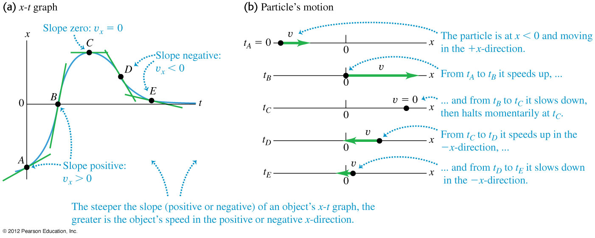
Instantaneous velocity from x-t graph for straight line motion
The instantaneous velocity at any point on x-t graph is equal to the slope of the tangent at that point.
Notes:
In the figures, the x-t graph of a particle is given along with a motion diagram showing the position and velocity of the particle at each of the times labeled on the x-t graph.

Slide 16
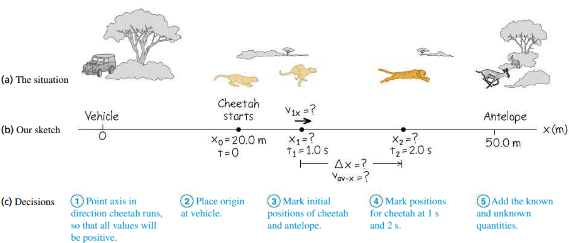
Example 3
A cheetah is crouched 20 m to the east of an observer sitting in a vehicle (see below figure). At t = 0 the cheetah begins to run due eastward toward an antelope that is 50 m to the east of the observer. During the first 2.0 s of the attack, the cheetah’s coordinate x varies with time according to x = 20 m + (5.0 m/s²)t² a) Find the cheetah’s displacement between t₁ = 1.0 s and t₂ = 2.0 s. b) Find the average velocity during that interval. c) Derive an expression for the cheetah’s instantaneous velocity as a function of time and use it to find v_{x} at t = 1.0 s and t = 2.0 s.
Notes:
a) 15 m b) 15 m/s c) 10.5 m/s d) (10 m/s²)t, 10 m/s, 20 m/s

Slide 17
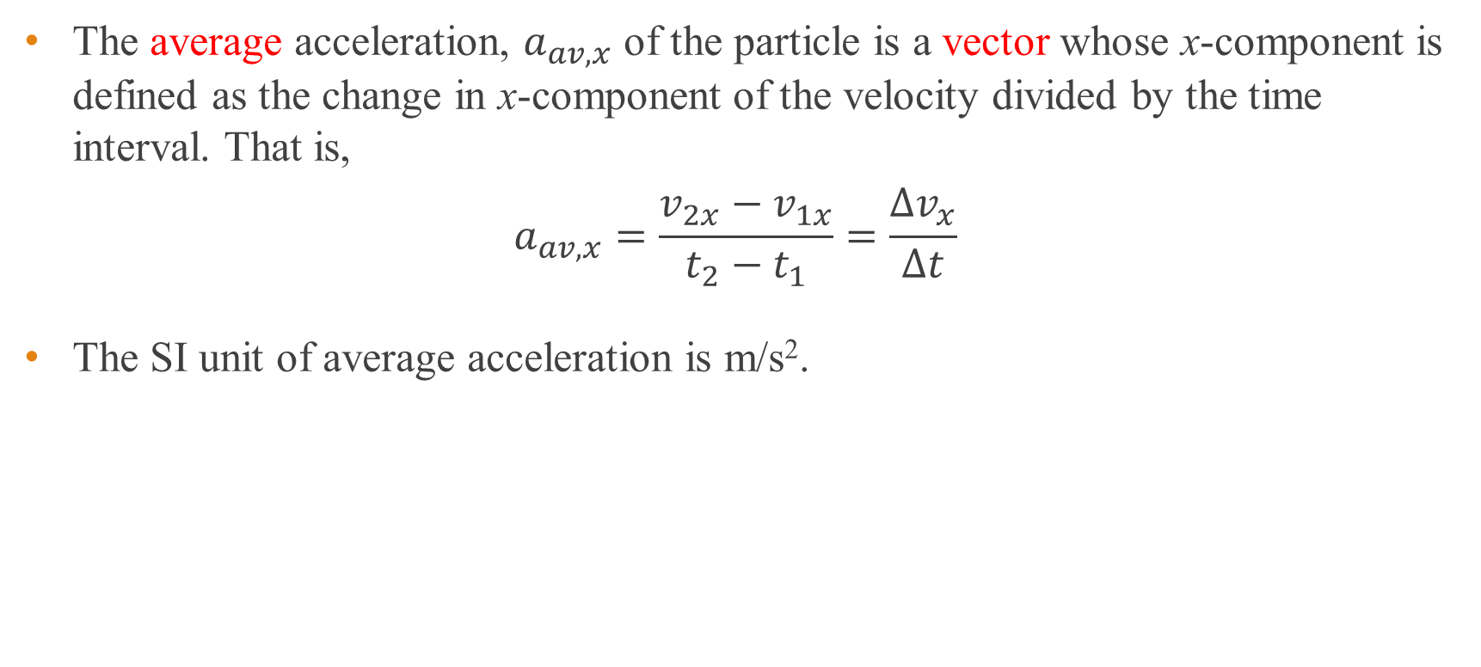
Average acceleration for straight line motion
The average acceleration, $a_{av,x}$ of the particle is a vector whose x-component is defined as the change in x-component of the velocity divided by the time interval. That is,
$$a_{av,x}=\frac{v_{2x}−v_{1x}}{t_{2}−t_{1}}=\frac{Δv_{x}}{Δt}$$
The SI unit of average acceleration is m/s².

Slide 18
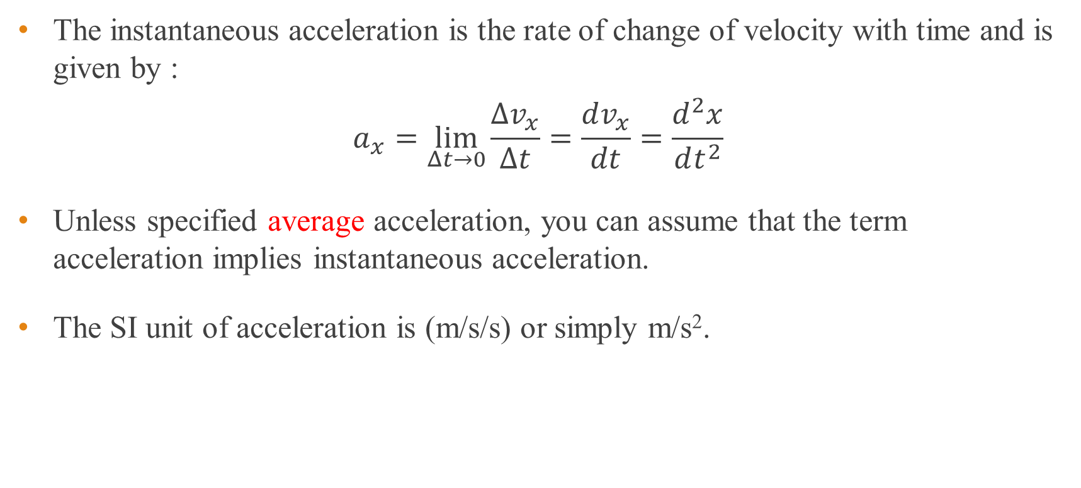
Instantaneous acceleration for straight line motion
The instantaneous acceleration is the rate of change of velocity with time and is given by :
$$a_{x}=\lim_{Δt→0}{\frac{Δv_{x}}{Δt}}=\frac{dv_{x}}{dt}=\frac{d^{2}x}{dt^{2}}$$
Unless specified average acceleration, you can assume that the term acceleration implies instantaneous acceleration.
The SI unit of acceleration is (m/s/s) or simply m/s².
Notes:
Just as we introduced instantaneous velocity, we define the instantaneous acceleration as the limit of the average acceleration as the time interval approaches zero.

Slide 19
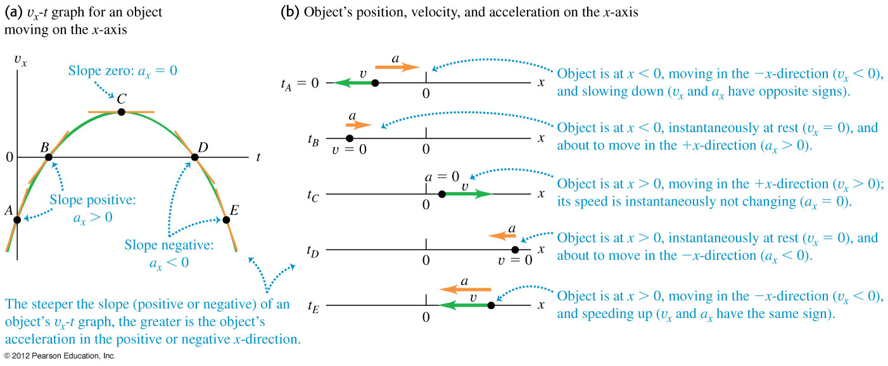
Instantaneous acceleration from v_{x}-t graph for straight line motion
The instantaneous acceleration at any point on the v-t graph is equal to the slope of the tangent to the curve at that point.
Notes:
In the figures, the v_{x}-t graph of a particle is given along with a motion diagram showing the position and velocity of the particle at each of the times labeled on the v_{x}-t graph.

Slide 20
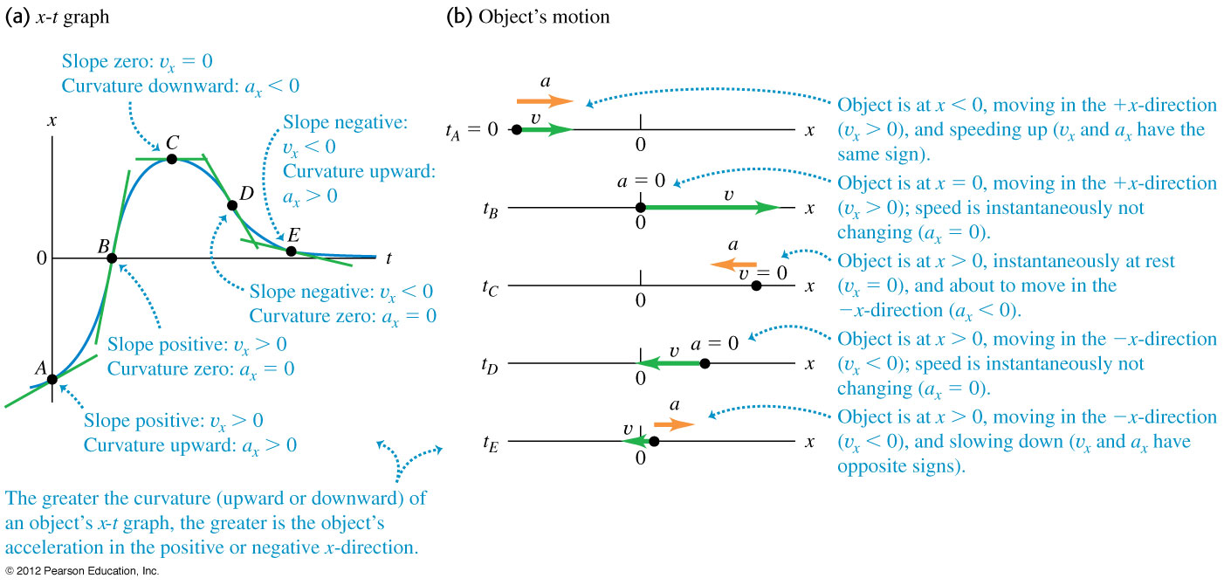
Instantaneous acceleration from x-t graph for straight line motion
On an x-t graph, the instantaneous acceleration at any point is given by the concavity or curvature of the graph at that point.
Notes:
In the figures, the x-t graph of a particle is given along with a motion diagram showing the position and velocity of the particle at each of the times labeled on the x-t graph.

Slide 21
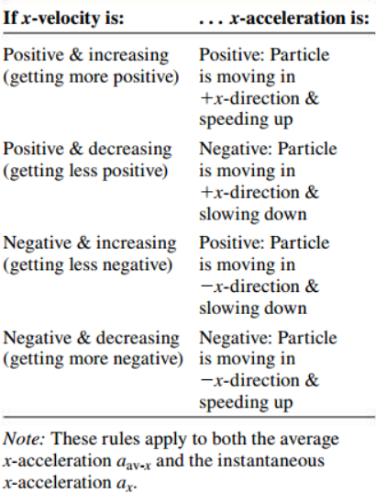
Rules for the sign of x-acceleration
Deceleration means a decrease in speed. Negative acceleration does not always mean a decrease in speed.
Notes:
In the figures, the x-t graph of a particle is given along with a motion diagram showing the position and velocity of the particle at each of the times labeled on the x-t graph.

Slide 22
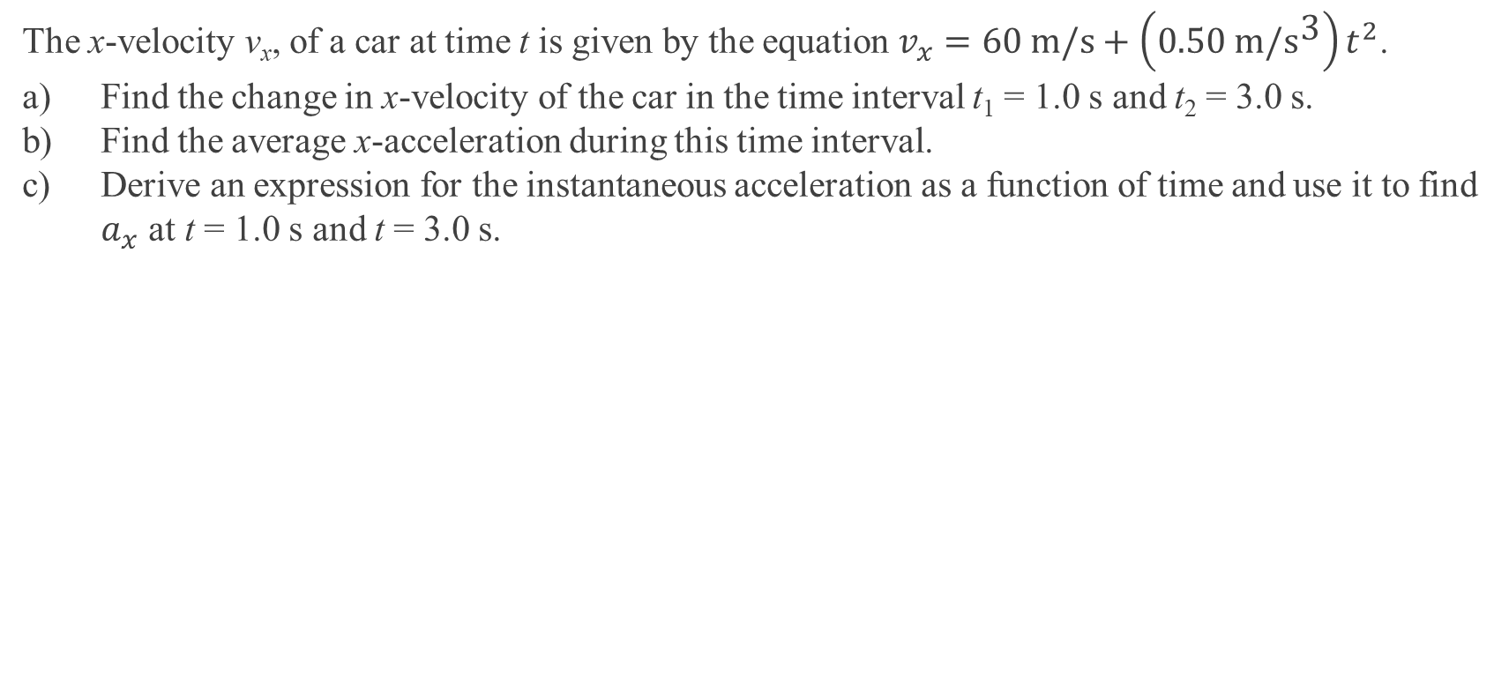
Example 4
The x-velocity v_{x}, of a car at time t is given by the equation $v_{x}=60 \text{m}\text{/}\text{s}+\left(0.50 \text{m}\text{/}{\text{s}}^{\text{3}}\right)t^{2}$. a) Find the change in x-velocity of the car in the time interval t₁ = 1.0 s and t₂ = 3.0 s. b) Find the average x-acceleration during this time interval. c) Derive an expression for the instantaneous acceleration as a function of time and use it to find $a_{x}$ at t = 1.0 s and t = 3.0 s.
Notes:
a) 4.0 m/s b) 2.0 m/s² c) 1.05 m/s² d) (1.0 m/s³) t, 1.0m/s², 3.0m/s²

Slide 23
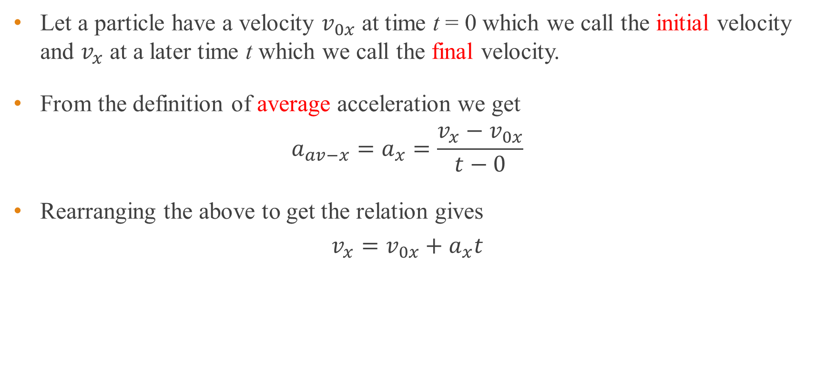
Straight line motion with constant acceleration
Let a particle have a velocity $v_{0x}$ at time t = 0 which we call the initial velocity and $v_{x}$ at a later time t which we call the final velocity.
From the definition of average acceleration we get
$$a_{av−x}=a_{x}=\frac{v_{x}−v_{0x}}{t−0}$$
Rearranging the above to get the relation gives
$$v_{x}=v_{0x}+a_{x}t$$

Slide 24
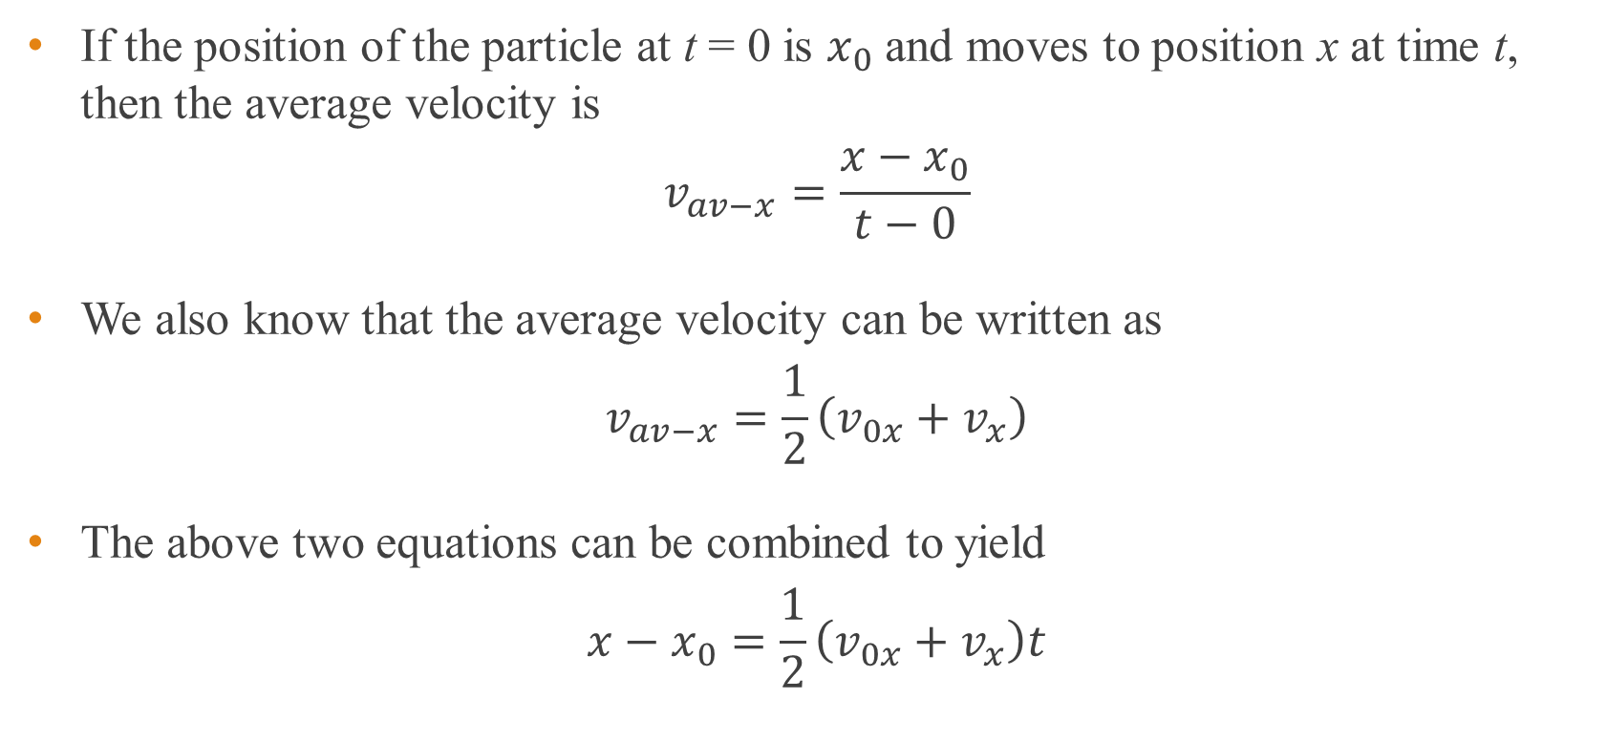
Straight line motion with constant acceleration
If the position of the particle at t = 0 is $x_{0}$ and moves to position x at time t, then the average velocity is
$$v_{av−x}=\frac{x−x_{0}}{t−0}$$
We also know that the average velocity can be written as
$$v_{av−x}=\frac{1}{2}\left(v_{0x}+v_{x}\right)$$
The above two equations can be combined to yield
$$x−x_{0}=\frac{1}{2}\left(v_{0x}+v_{x}\right)t$$

Slide 25
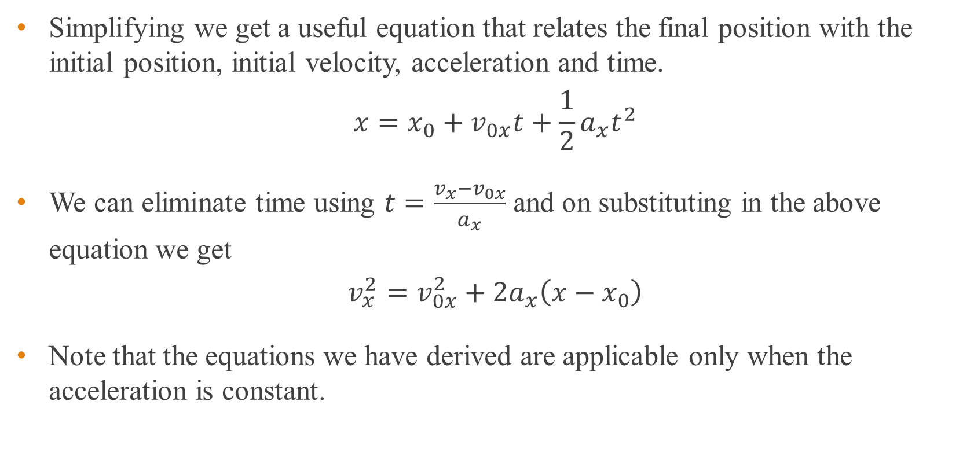
Straight line motion with constant acceleration
Simplifying we get a useful equation that relates the final position with the initial position, initial velocity, acceleration and time.
$$x=x_{0}+v_{0x}t+\frac{1}{2}a_{x}t^{2}$$
We can eliminate time using $t=\frac{v_{x}−v_{0x}}{a_{x}}$ and on substituting in the above equation we get
$$v_{x}^{2}=v_{0x}^{2}+2a_{x}\left(x−x_{0}\right)$$
Note that the equations we have derived are applicable only when the acceleration is constant.

Slide 26
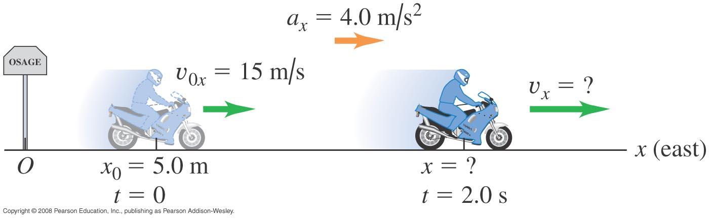
Example 5
A motorcyclist heading east through a small town accelerates at a constant 4.0 m/s² after he leaves the city limits (see below figure). At time t = 0 he is 5.0 m east of the city-limits signpost, moving east at 15 m/s. a) Find his position and velocity at t = 2.0 s. b) Where is he when his velocity is 25 m/s?
Notes:
a) x = 43m, v = 23 m/s b) x = 55 m

Slide 27
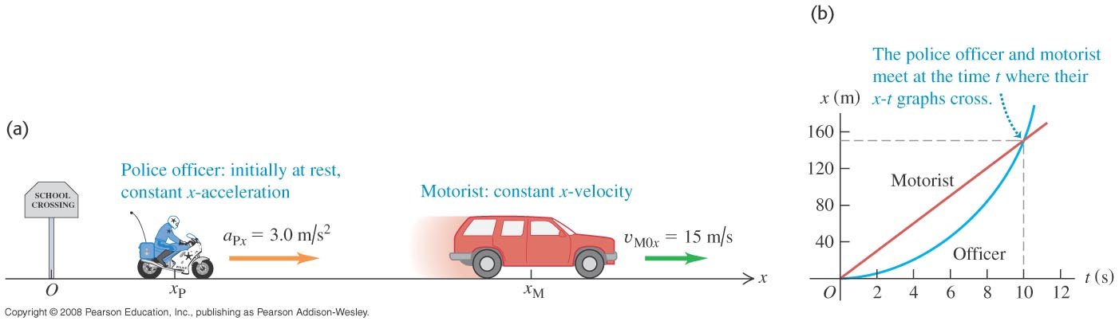
Example 6
A motorist travelling with a constant speed of 15 m/s passes a school-crossing corner where the speed limit is 10 m/s. Just as the motorist passes the school-crossing sign, a police officer on a motorcycle, initially at rest, starts in pursuit with a constant acceleration of 3.0 m/s² (see below figure). a) How much time elapses before the officer passes the motorist? b) At that time, what distance has each vehicle travelled?
Notes:
a) 10 s b) 150 m

Slide 28
Graphs of uniform velocity
a) Displacement increases linearly with time.
b) Velocity remains the same with time.
c) Acceleration is zero.
Displacement
Velocity
Acceleration
0
0
0
Time
Time
Time
(a)
(b)
(c)
Notes:
a) 10 s b) 150 m

Slide 29
Graphs of uniform acceleration
a) Displacement increases non-linearly with time.
b) Velocity increases linearly with time.
c) Acceleration is non zero and constant with time.
Displacement
Velocity
Acceleration
0
0
Time
0
Time
Time
(a)
(b)
(c)
Notes:
a) 10 s b) 150 m

Slide 30
Free fall - one dimensional motion with constant acceleration
Free fall motion is when an object falls under earth’s gravity assuming that
there is no air resistance,
the distance of the fall is small compared to the radius of the earth,
the rotation of the earth is not important .
The acceleration due to gravity is taken to be a constant irrespective of the size and mass of the object.
The magnitude of the acceleration due to gravity on Earth’s surface is 9.80 m/s².
Notes:
The direction of the acceleration due to gravity is downwards. If we use positive direction to be upward then the acceleration is equal to –g.

Slide 31
Example 7
You throw a ball vertically upward from the roof of a tall building. The ball leaves your hand at a point even with the roof railing with an upward speed of 15.0 m/s. On its way back down, it just misses the railing.
a) Find the ball’s position and velocity 1.00 s and 4.00 s after leaving your hand.
b) Find the ball’s velocity when it is 5.00 m above the railing.
c) Find the maximum height reached.
d) Find the ball’s acceleration when it is at its maximum height.
e) At what time after being released has the ball fallen 5.00 m below the roof railing?
Notes:
a) +10.1m, +5.2 m/s, -18.4 m, -24.2 m/s b) +11.3 m/s, -11.3 m/s c) +11.5 m d) -9.80 m/s² e) 3.36 s

Slide 32
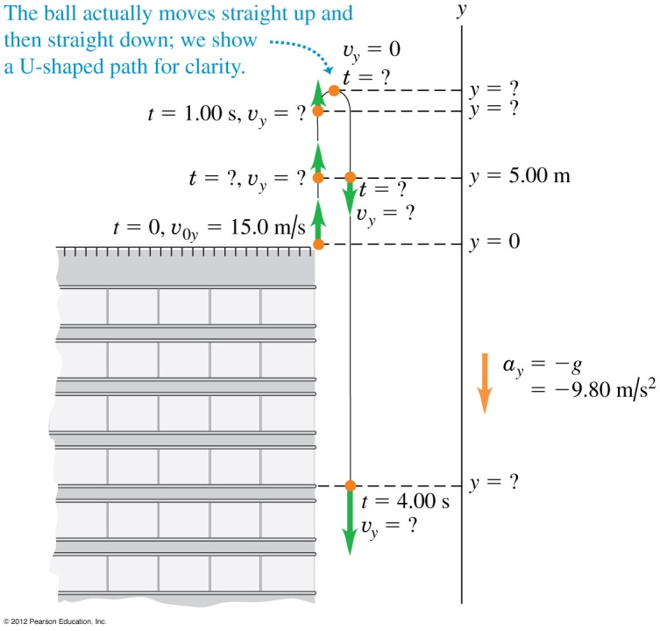
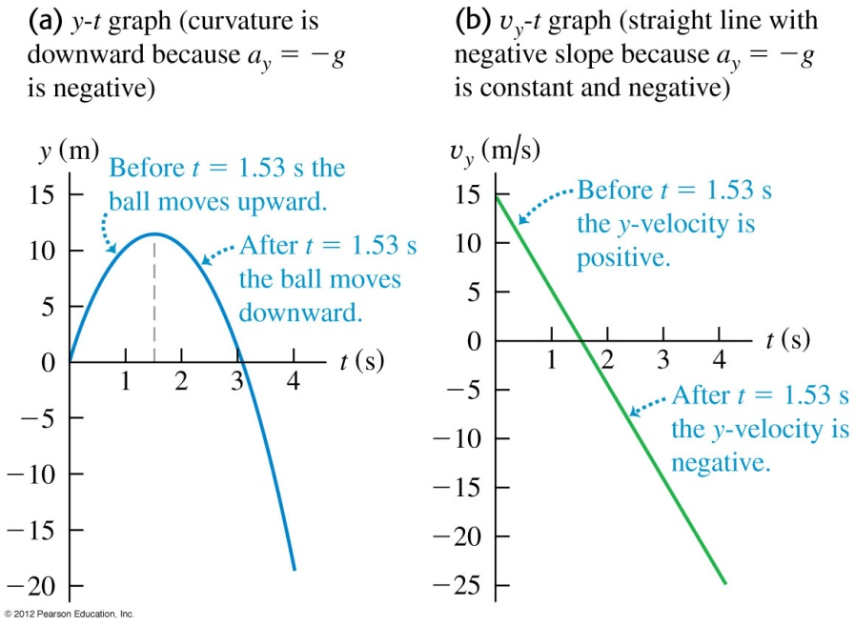
Example 7 - cont

Slide 33
Motion in two and three dimensions
Examples include a merry-go-round undergoes a circular motion, a base ball when hit may move in path that is not a straight line.
The equations that we set up for studying motion in one dimension will be extended to two and three dimensions.

Slide 34
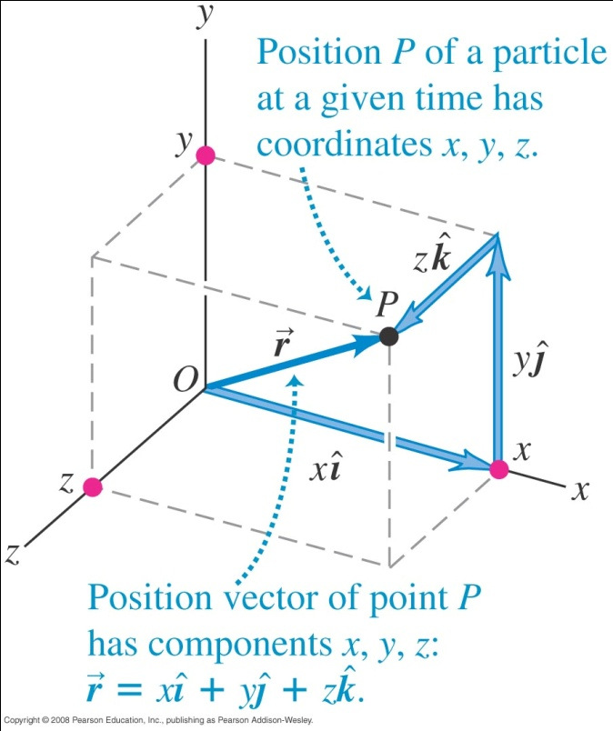
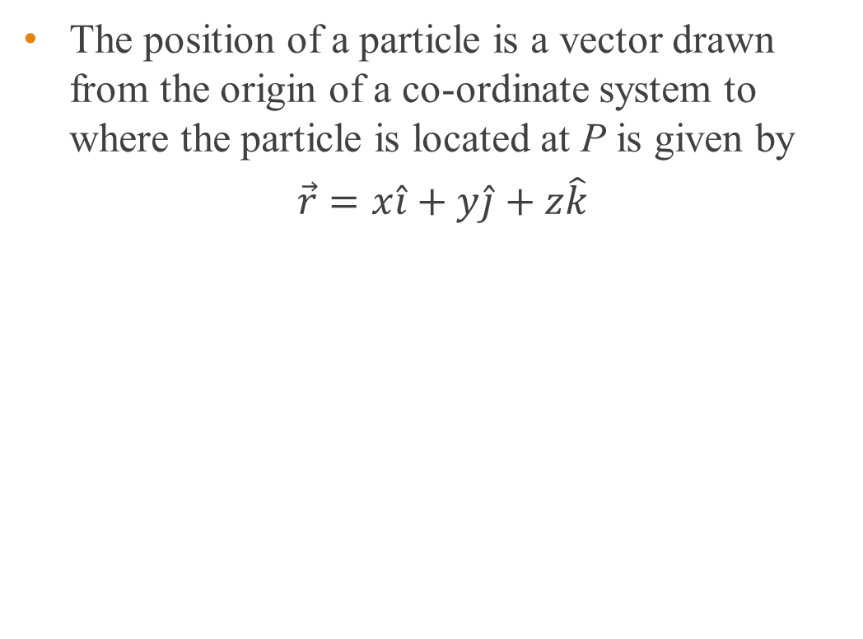
Position vector
The position of a particle is a vector drawn from the origin of a co-ordinate system to where the particle is located at P is given by
$$\vec{r}=x\hat{i}+y\hat{j}+z\hat{k}$$

Slide 35
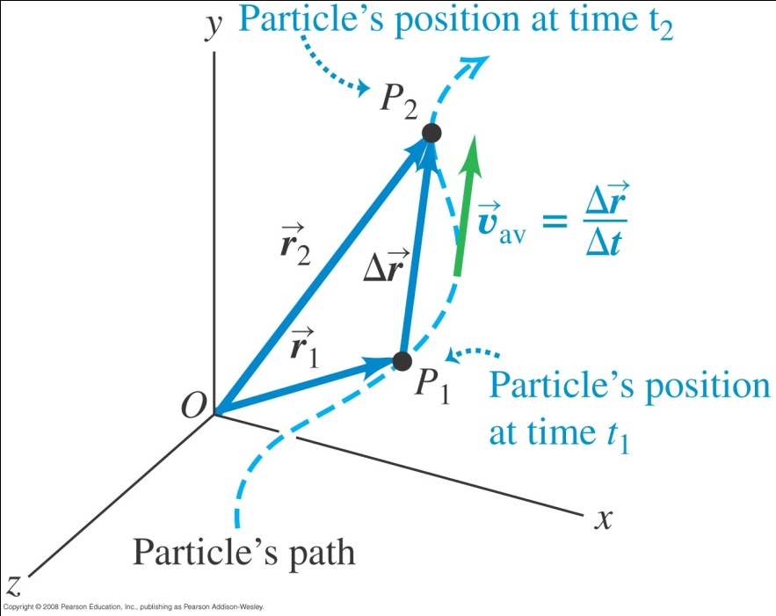
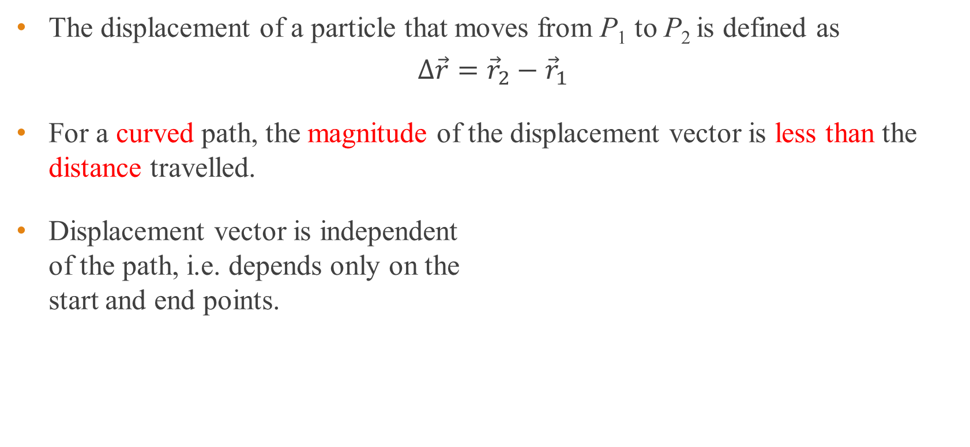
Displacement vector
The displacement of a particle that moves from P₁ to P₂ is defined as
$$Δ\vec{r}={\vec{r}}_{2}−{\vec{r}}_{1}$$
For a curved path, the magnitude of the displacement vector is less than the distance travelled.
Displacement vector is independent of the path, i.e. depends only on the start and end points.

Slide 36

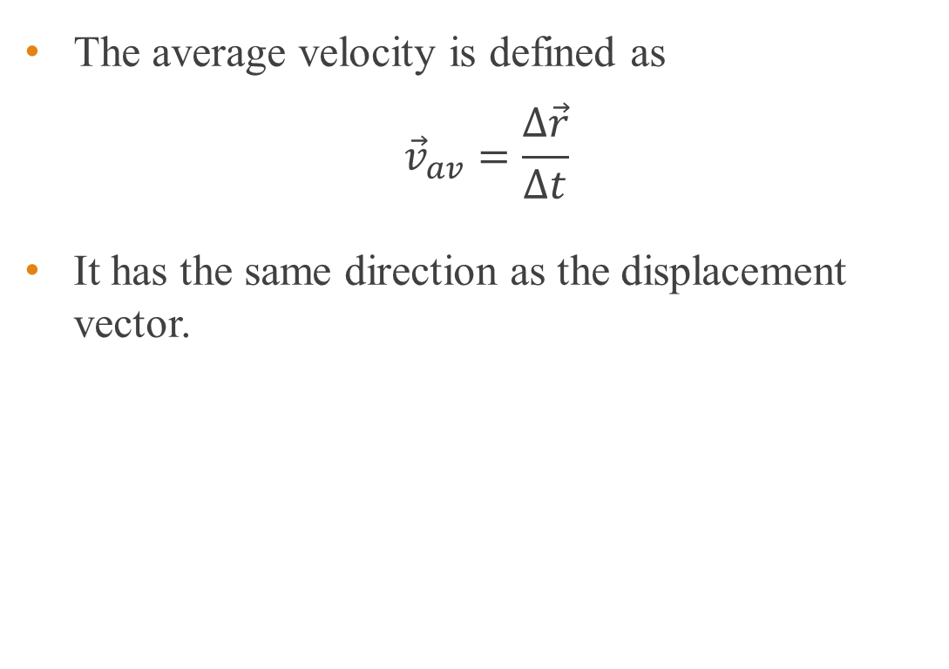
Average velocity
The average velocity is defined as
$${\vec{v}}_{av}=\frac{Δ\vec{r}}{Δt}$$
It has the same direction as the displacement vector.

Slide 37
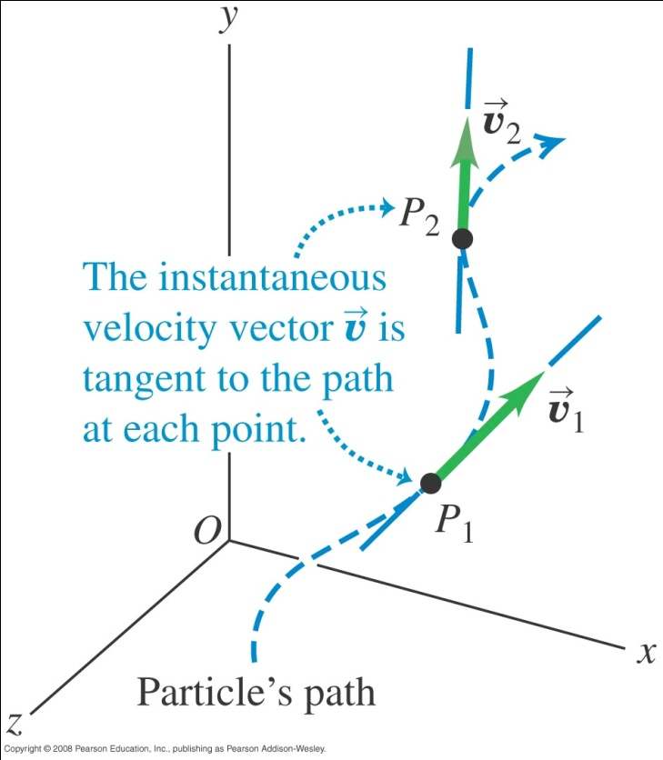
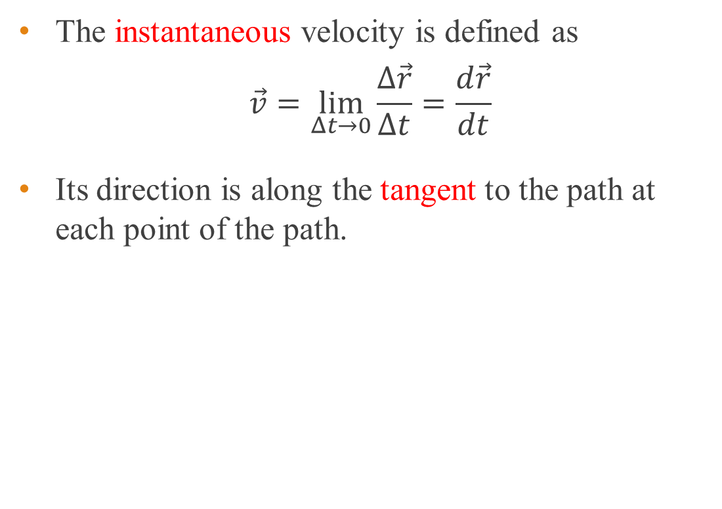
Instantaneous velocity
The instantaneous velocity is defined as
$$\vec{v}=\lim_{Δt→0}{\frac{Δ\vec{r}}{Δt}}=\frac{d\vec{r}}{dt}$$
Its direction is along the tangent to the path at each point of the path.

Slide 38
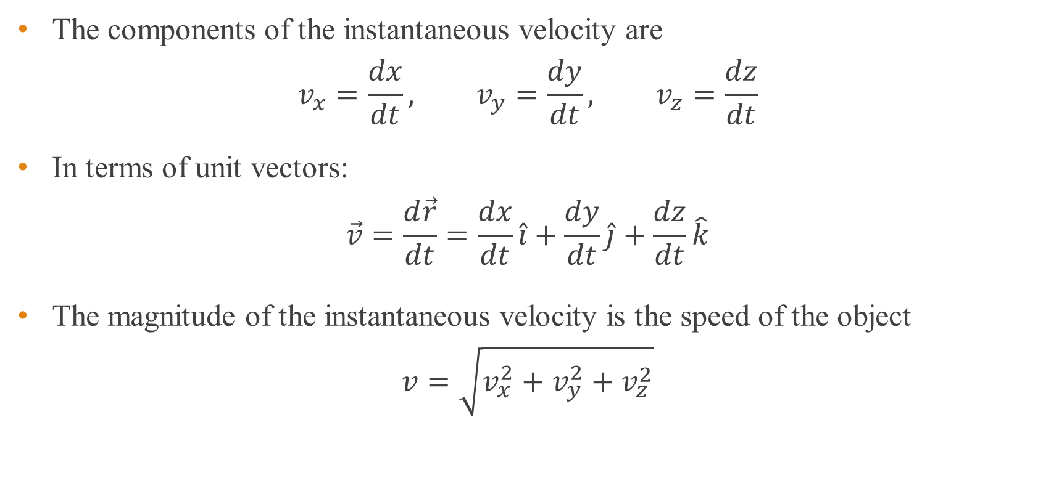
Instantaneous velocity
The components of the instantaneous velocity are
$$v_{x}=\frac{dx}{dt}, v_{y}=\frac{dy}{dt}, v_{z}=\frac{dz}{dt}$$
In terms of unit vectors:
$$\vec{v}=\frac{d\vec{r}}{dt}=\frac{dx}{dt}\hat{i}+\frac{dy}{dt}\hat{j}+\frac{dz}{dt}\hat{k}$$
The magnitude of the instantaneous velocity is the speed of the object
$$v=\sqrt{v_{x}^{2}+v_{y}^{2}+v_{z}^{2}}$$

Slide 39
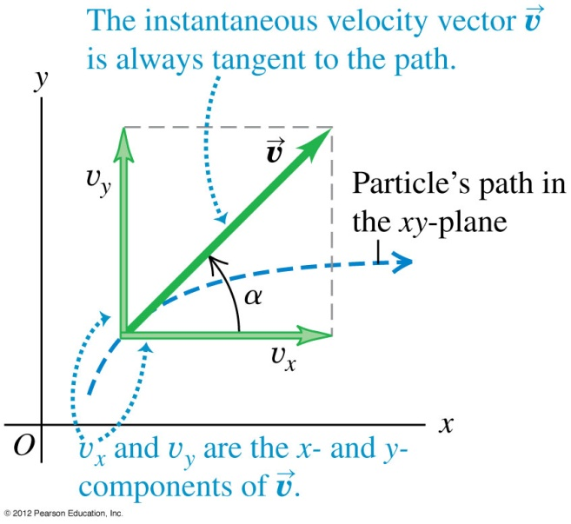
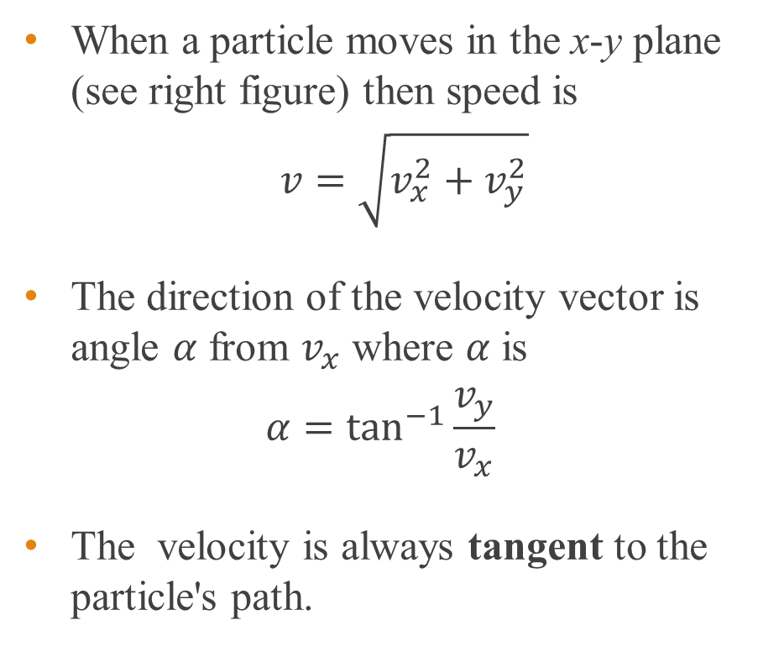
Motion in x-y plane
When a particle moves in the x-y plane (see right figure) then speed is
$$v=\sqrt{v_{x}^{2}+v_{y}^{2}}$$
The direction of the velocity vector is angle $α$ from $v_{x}$ where $α$ is
$$α=\tan^{−1}{\frac{v_{y}}{v_{x}}}$$
The velocity is always tangent to the particle's path.

Slide 40
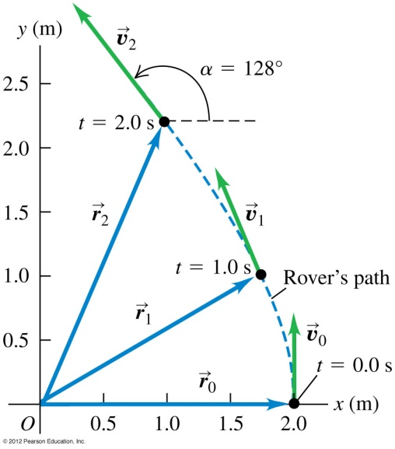
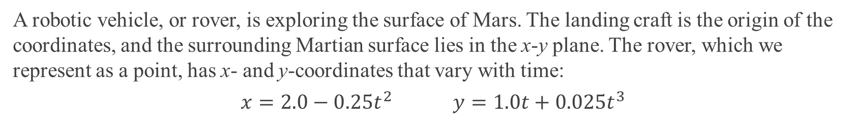
Example 9
A robotic vehicle, or rover, is exploring the surface of Mars. The landing craft is the origin of the coordinates, and the surrounding Martian surface lies in the x-y plane. The rover, which we represent as a point, has x- and y-coordinates that vary with time:
$$x=2.0−0.25t^{2} y=1.0t+0.025t^{3}$$
Find the rover’s coordinates and its distance from the lander at t = 2.0 s.
Find the rover’s displacement and average velocity vectors during the time interval from t = 0.0 s to t = 2.0 s.
Derive a general expression for the rover’s instantaneous velocity vector.
Express the instantaneous velocity at t = 2.0 s in component form and also in terms of magnitude and direction.
Notes:
(1.0m, 2.2m), 2.4 m b) (-1.0 m)i + (2.2 m)j, (-0.50 m/s)i + (1.1 m/s)j, c) (-0.50 m/s²)ti + [(1.0 m/s) + (0.075 m/s³)t²] j
d) -1.0 m/s, 1.3 m/s, 1.6 m/s, 38º west of north

Slide 41
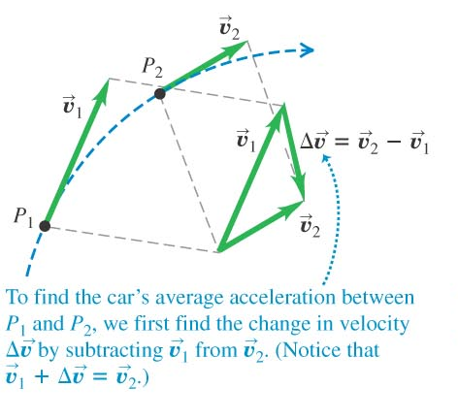
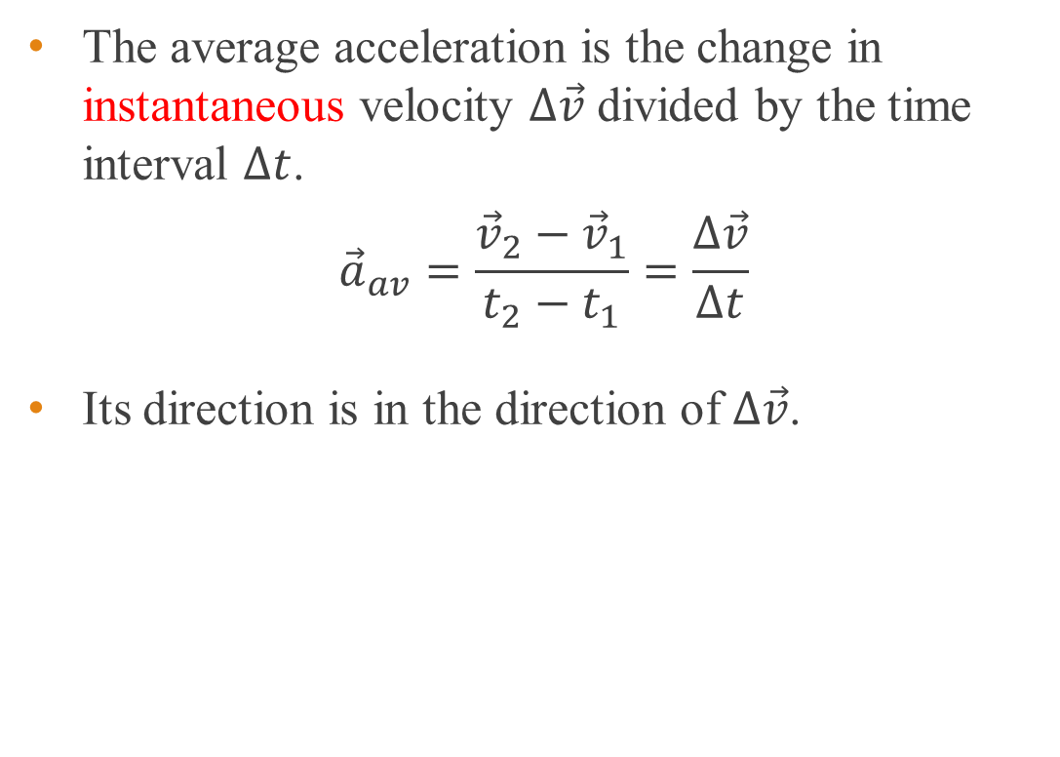
Average acceleration
The average acceleration is the change in instantaneous velocity $Δ\vec{v}$ divided by the time interval $Δt$.
$${\vec{a}}_{av}=\frac{{\vec{v}}_{2}−{\vec{v}}_{1}}{t_{2}−t_{1}}=\frac{Δ\vec{v}}{Δt}$$
Its direction is in the direction of $Δ\vec{v}$.

Slide 42
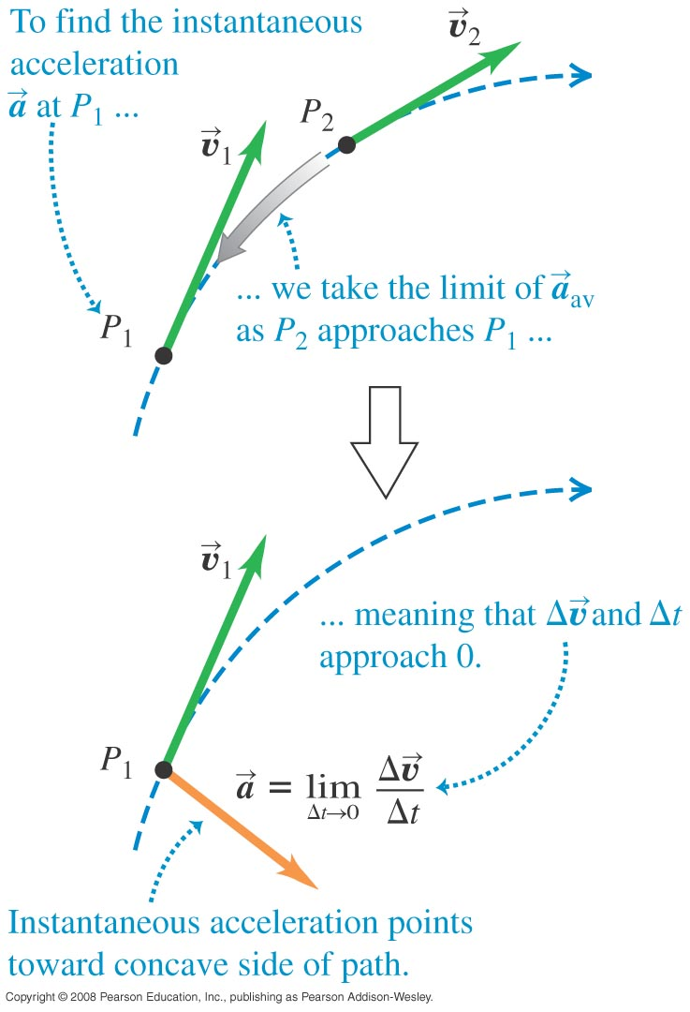
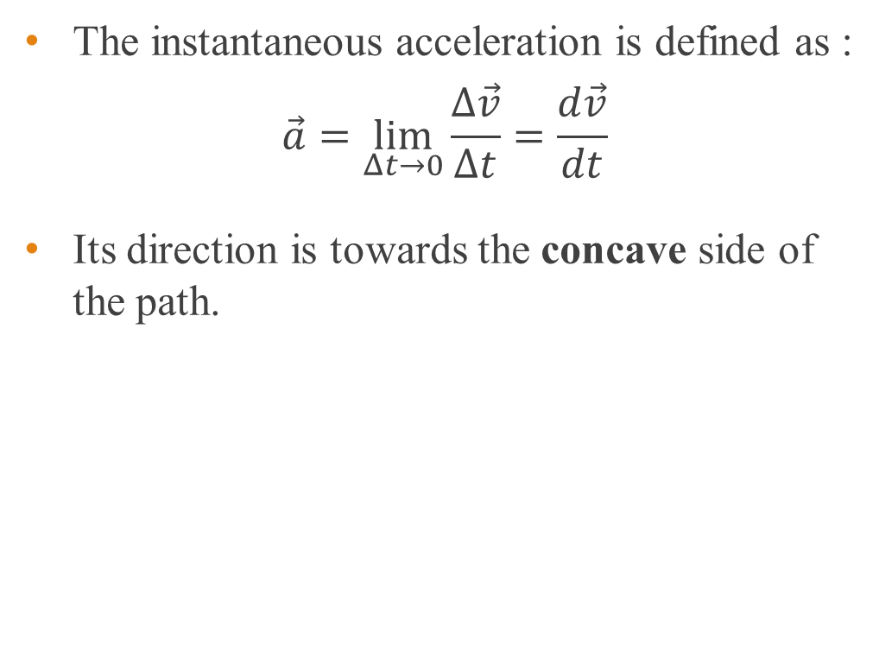
Instantaneous acceleration
The instantaneous acceleration is defined as :
$$\vec{a}=\lim_{Δt→0}{\frac{Δ\vec{v}}{Δt}}=\frac{d\vec{v}}{dt}$$
Its direction is towards the concave side of the path.

Slide 43
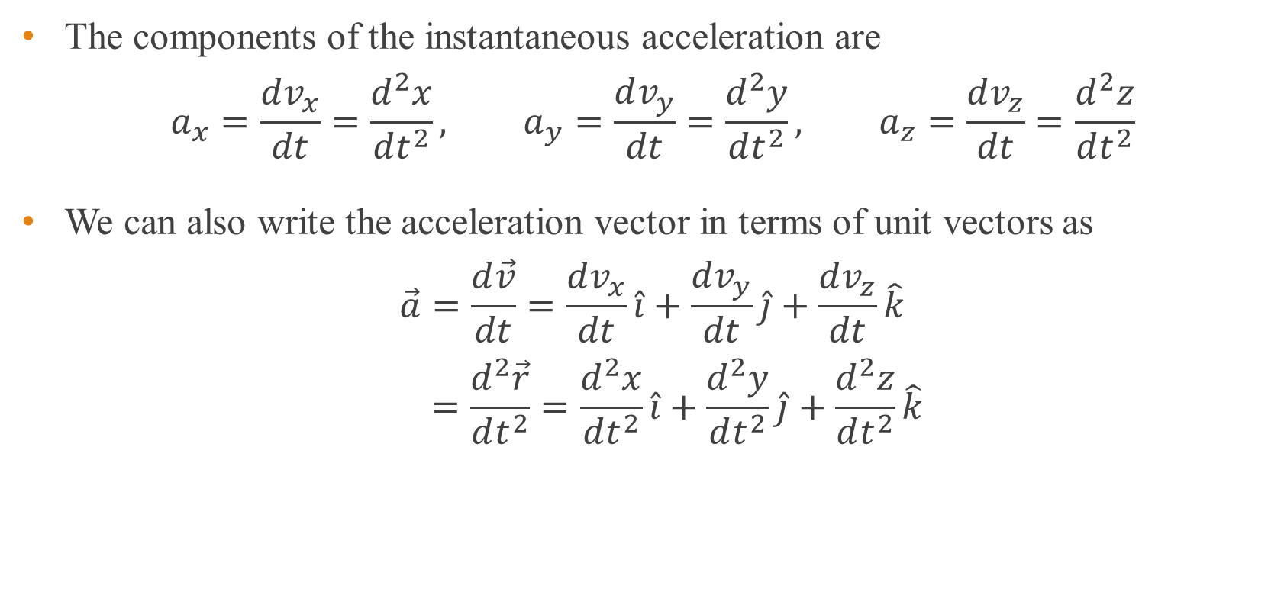
Instantaneous acceleration
The components of the instantaneous acceleration are
$$a_{x}=\frac{dv_{x}}{dt}=\frac{d^{2}x}{dt^{2}}, a_{y}=\frac{dv_{y}}{dt}=\frac{d^{2}y}{dt^{2}}, a_{z}=\frac{dv_{z}}{dt}=\frac{d^{2}z}{dt^{2}}$$
We can also write the acceleration vector in terms of unit vectors as
$$\vec{a}=\frac{d\vec{v}}{dt}=\frac{dv_{x}}{dt}\hat{i}+\frac{dv_{y}}{dt}\hat{j}+\frac{dv_{z}}{dt}\hat{k}$$
$$=\frac{d^{2}\vec{r}}{dt^{2}}=\frac{d^{2}x}{dt^{2}}\hat{i}+\frac{d^{2}y}{dt^{2}}\hat{j}+\frac{d^{2}z}{dt^{2}}\hat{k}$$

Slide 44
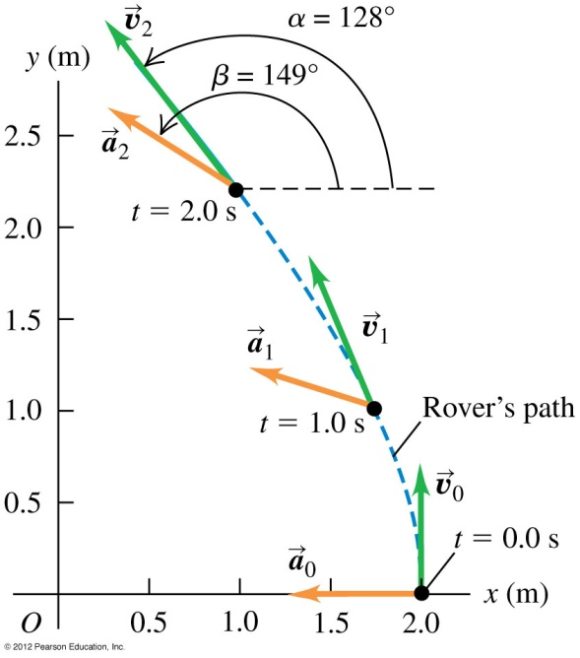
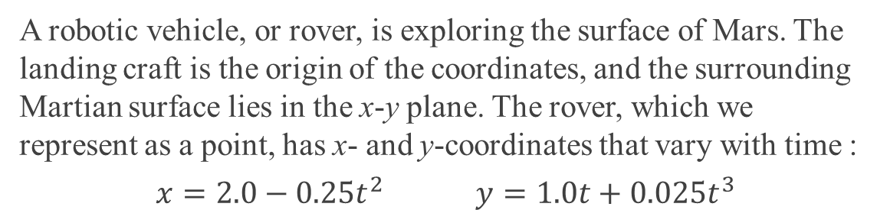
Example 10
A robotic vehicle, or rover, is exploring the surface of Mars. The landing craft is the origin of the coordinates, and the surrounding Martian surface lies in the x-y plane. The rover, which we represent as a point, has x- and y-coordinates that vary with time :
$$x=2.0−0.25t^{2} y=1.0t+0.025t^{3}$$
Find the components of the average acceleration during the time interval from t = 0.0 s to t = 2.0 s.
Find the instantaneous acceleration at t = 2.0 s.
Notes:
-0.50 m/s², 0.15 m/s² b) (-0.50 m/s²)i + (0.30 m/s²)j

Slide 45
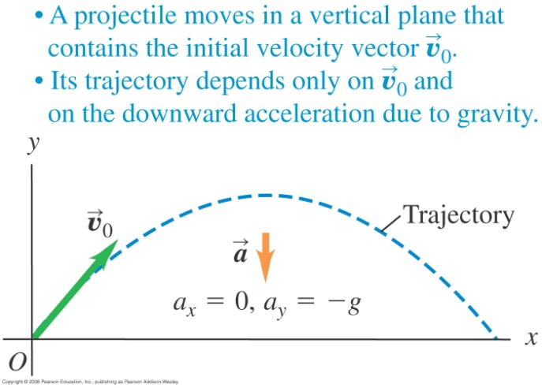
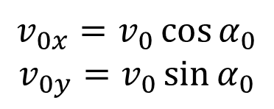
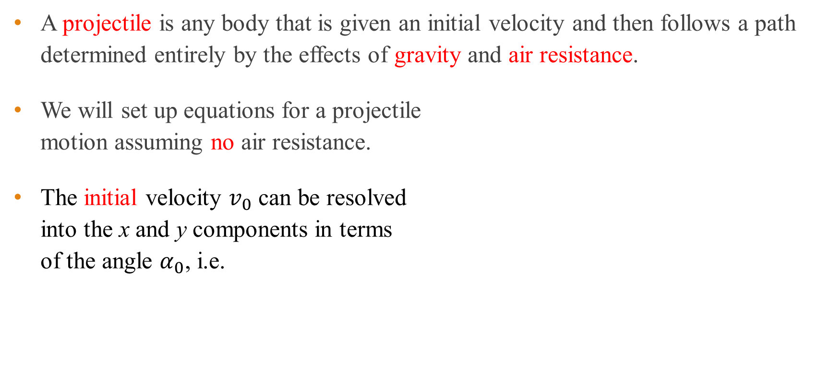
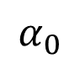
Projectile motion
A projectile is any body that is given an initial velocity and then follows a path determined entirely by the effects of gravity and air resistance.
We will set up equations for a projectile motion assuming no air resistance.
The initial velocity $v_{0}$ can be resolved into the x and y components in terms of the angle $α_{0}$, i.e.
$$v_{0x}=v_{0}\cos{α_{0}}$$
$$v_{0y}=v_{0}\sin{α_{0}}$$
$$α_{0}$$

Slide 46
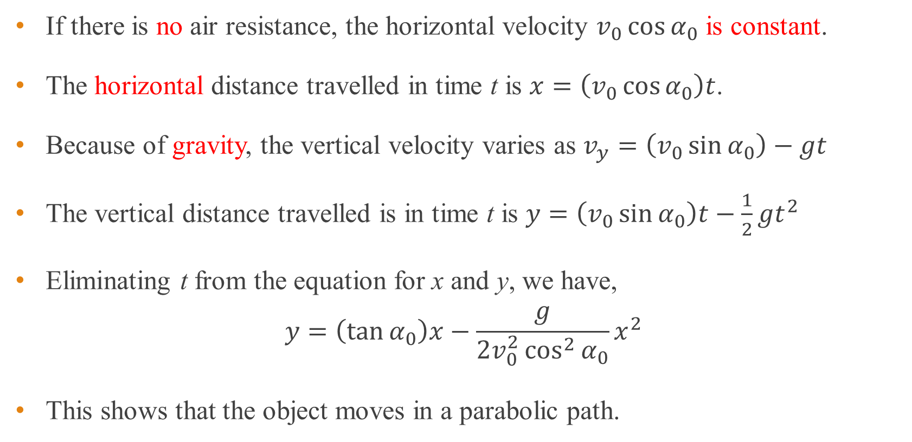
Projectile motion
If there is no air resistance, the horizontal velocity $v_{0}\cos{α_{0}}$ is constant.
The horizontal distance travelled in time t is $x=\left(v_{0}\cos{α_{0}}\right)t$.
Because of gravity, the vertical velocity varies as $v_{y}=\left(v_{0}\sin{α_{0}}\right)−gt$
The vertical distance travelled is in time t is $y=\left(v_{0}\sin{α_{0}}\right)t−\frac{1}{2}gt^{2}$
Eliminating t from the equation for x and y, we have,
$$y=\left(\tan{α_{0}}\right)x−\frac{g}{2v_{0}^{2}\cos^{2}{α_{0}}}x^{2}$$
This shows that the object moves in a parabolic path.

Slide 47
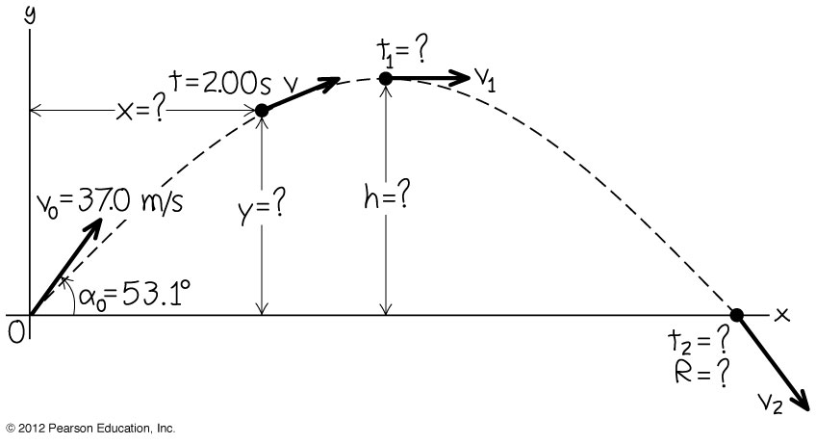
Example 11
A batter hits a baseball so that it leaves the bat at speed v₀ = 37.0 m/s at an angle α₀ = 53.1º.
a) Find the position of the ball and its velocity at t = 2.00 s.
b) Find the time when the ball reaches the highest point of its flight and its height h, at this time.
c) Find the horizontal range R which is the maximum horizontal distance travelled by the ball.
Notes:
a) (44.4 m, 39.6 m), 24.4 m/s, 24.2º above the horizontal b) 3.02 s, 44.7 m c) 134 m

Slide 48
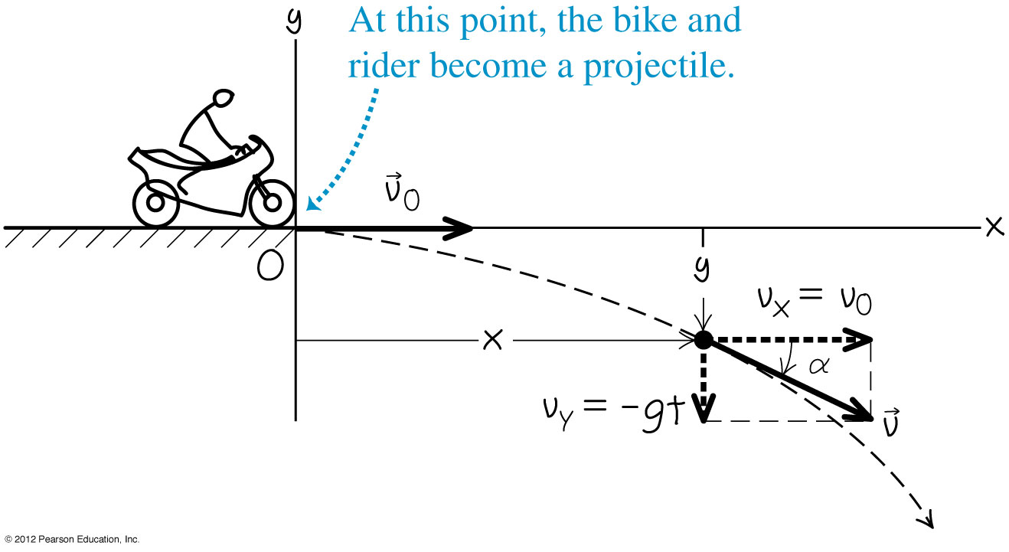
Example 12
A motorcycle stunt rider rides off the edge of a cliff. Just at the edge his velocity is horizontal, with magnitude 9.0 m/s. Find the motorcycle’s (a) position (b) distance from the edge of the cliff and (c) velocity 0.5 s after it leaves the edge of the cliff.
Notes:
a) (4.5 m, -1.2 m) b) 4.7 m c) 10.2 m/s, 29º below horizontal

Slide 49


Example 13
Find the maximum height h and horizontal range R of a projectile launched with speed v₀ at and initial angle α₀ between 0º and 90º .
a) For a given $v_{0}$, what value of α₀ gives maximum height?
b) What value of α₀ gives maximum horizontal range?
Notes:
a) v₀²sin²α₀/2g, v₀²sin2α₀/g b) 90º c) 45º

Slide 50

Example 14
A monkey escapes from the zoo and climbs a tree. After failing to entice the monkey down, the zookeeper fires a tranquilizer dart directly at the monkey (see right figure). The monkey lets go at the instant the dart leaves the gun. Show that the dart will always hit the monkey, provided that the dart reaches the monkey before the monkey hits the ground and runs away.

Slide 51
Relative velocity
The velocity of a moving body seen by an observer is called relative velocity.
The observer may be stationary or moving.
To study relative velocity we need a frame of reference.
A frame of reference is a coordinate system plus a time scale.

Slide 52


Relative velocity in 1D
In figure (b), the x position of P relative to A is
$${\vec{x}}_{P/A}={\vec{x}}_{P/B}+{\vec{x}}_{B/A}$$
Imagine the subscripts as a fraction and split it as P/A = P/B × B/A.
The velocity of P relative to A is obtained by differentiation.
$$\frac{d{\vec{x}}_{P/A}}{dt}=\frac{d{\vec{x}}_{P/B}}{dt}+\frac{d{\vec{x}}_{B/A}}{dt}$$
$${\vec{v}}_{P/A}={\vec{v}}_{P/B}+{\vec{v}}_{B/A}$$

Slide 53


Relative velocity in 2D and 3D
In 2D and 3D, the velocity of P relative to A is obtained by differentiating the position vector
$${\vec{r}}_{P/A}={\vec{r}}_{P/B}+{\vec{r}}_{B/A}$$
$$\frac{d{\vec{r}}_{P/A}}{dt}=\frac{d{\vec{r}}_{P/B}}{dt}+\frac{d{\vec{r}}_{B/A}}{dt}$$
$${\vec{v}}_{P/A}={\vec{v}}_{P/B}+{\vec{v}}_{B/A}$$

Slide 54

Example 15a
a) An air-plane’s compass indicates that it is headed due north and its airspeed indicator shows that it is moving through the air at 240 km/h. If there is a 100-km/h wind from west to east, what is the velocity of the airplane relative to the earth?
Notes:
a) 260 km/h, 23º east of north b) 218 km/h, 25º west of north

Slide 55

Example 15b
b) With the same wind and airspeed, in what direction should the airplane head to travel due north? What will be the velocity of the airplane relative to the earth?
Notes:
a) 260 km/h, 23º east of north b) 218 km/h, 25º west of north

Slide 56
Optional Slides

Slide 57

Motion with a non-uniform acceleration
The following equations are useful in the case of non-uniform acceleration.
$$\vec{a}=\frac{d\vec{v}}{dt}$$
Integrating the above equation, we get $\vec{v}={\vec{v}}_{0}+\int_{0}^{t}{\vec{a} dt}$
$$\vec{v}=\frac{d\vec{r}}{dt}$$
Integrating, we get $\vec{r}={\vec{r}}_{0}+\int_{0}^{t}{\vec{v} dt}$

Slide 58


Example 16
Sally is driving along a straight highway. At t = 0, when she is moving at 10 m/s in the positive x-direction, she passes a sign-post at x = 50 m. Her x-acceleration as a function of time is $a_{x}=2.0−0.10t$ m/s². a) Find her x-velocity $v_{x}$ and position x as functions of time. b) When is her x-velocity maximum?
c) What is that maximum x-velocity?
Notes:
v_{x} = 10 m/s + (2.0 m/s²) t - (0.5 m/s³)t² , x =50 m + (10 m/s)t + (2.0 m/s²) t²/2 - (0.5 m/s³)t³/6 b) 20 s
c) 30 m/s d) 517 m

Slide 59
End of chapter

